Slide 1
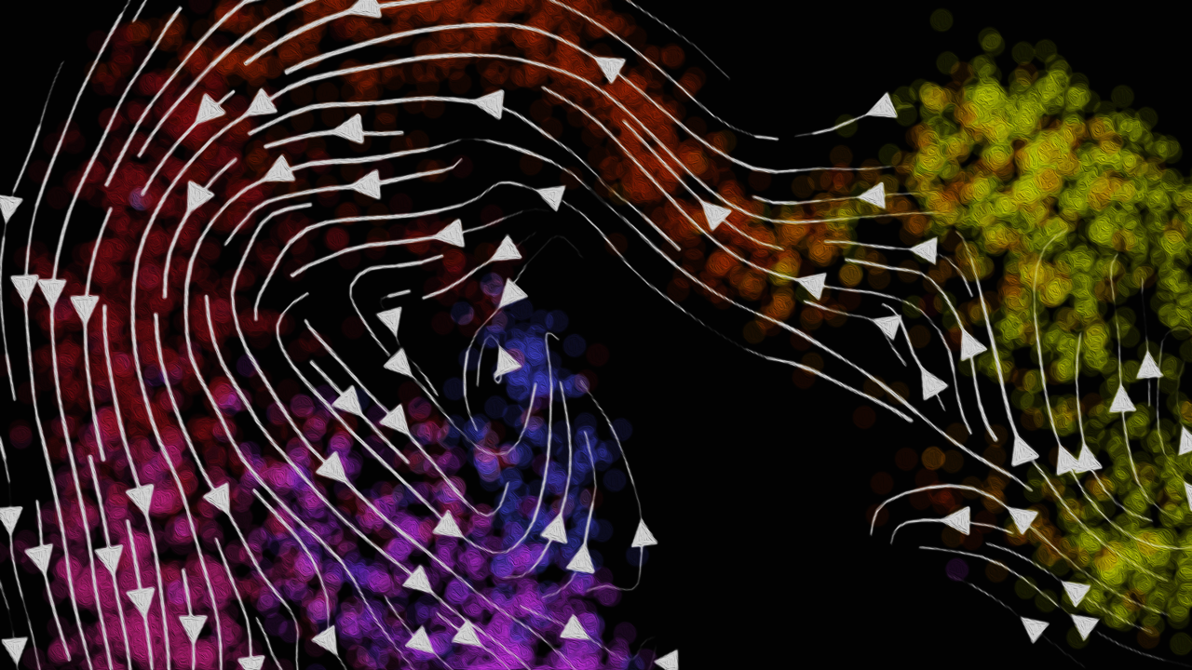
Modeling and Visualizing
RNA Velocity
Jean Fan, PhD
Assistant Professor
Center for Computational Biology
Department of Biomedical Engineering
Johns Hopkins University

Slide 2
Slight reshuffling of lectures
Today 2/19: RNA velocity
hwEC1 – use gganimate
Friday 2/21: Deconvolution
hwEC2 – run deconvolution on eevee dataset, compare with pikachu
Monday 2/24: spatial proteomics and epigenomics
hw5 – analyze spatial proteomics dataset
Wednesday 2/26: Moran’s I
Friday 2/28: Review and quiz
Monday 3/3: Guest lecture + assign final projects
Wednesday 3/5: Guest lecture + work on final projects
Friday 3/7: Class canceled for Stand Up for Science + work on final projects
After that: Final presentations!

Slide 3


Slide 4
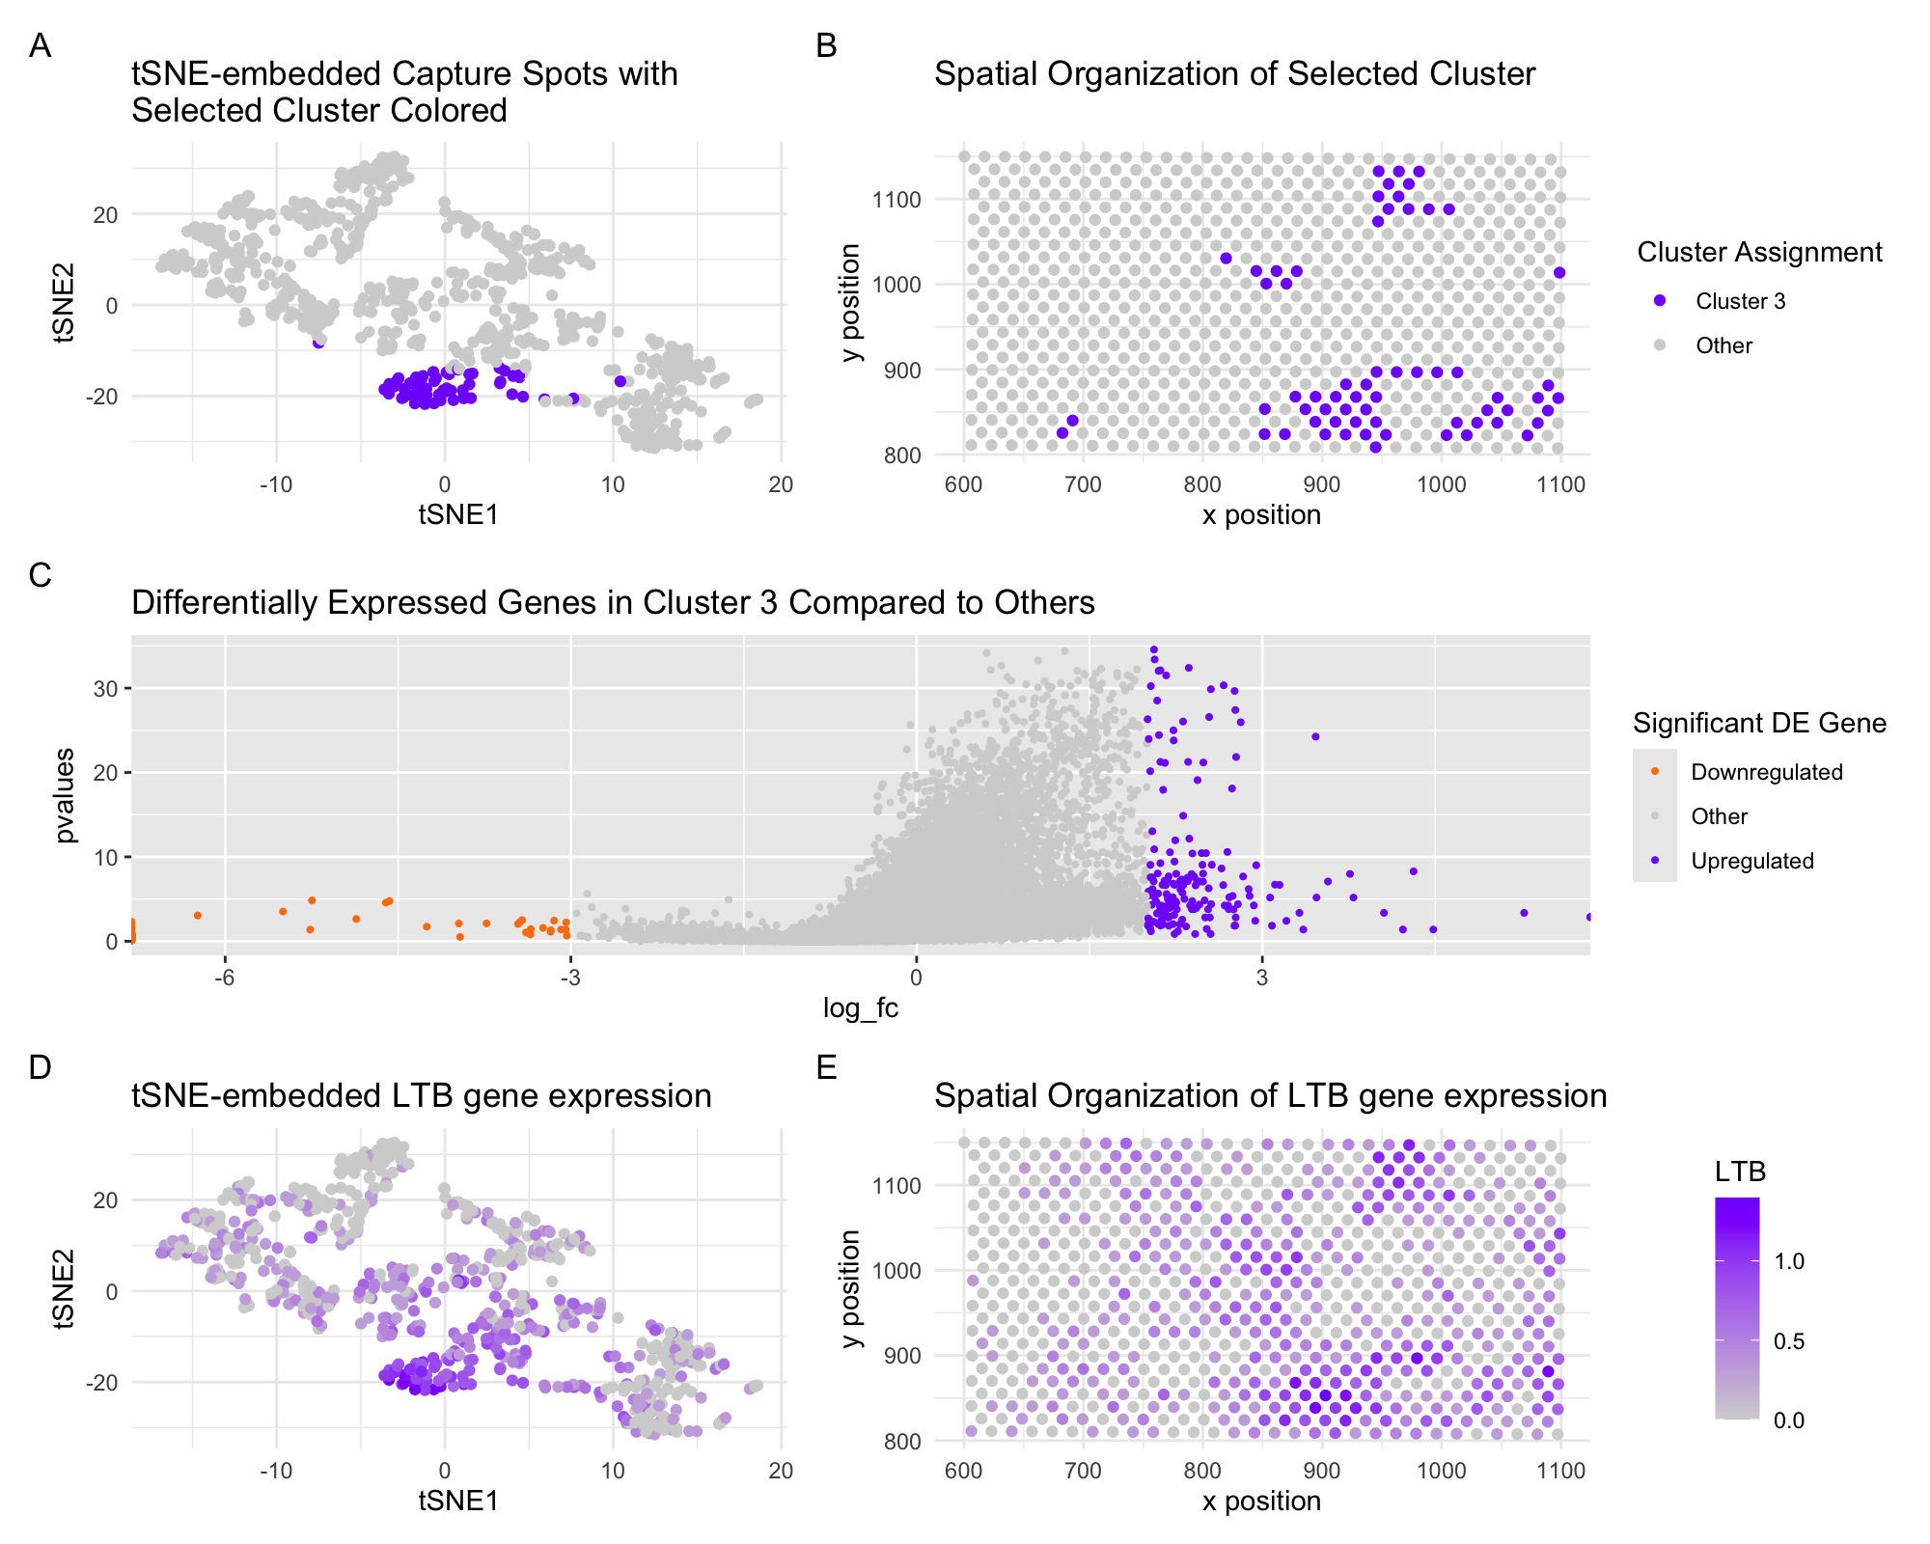


Slide 5
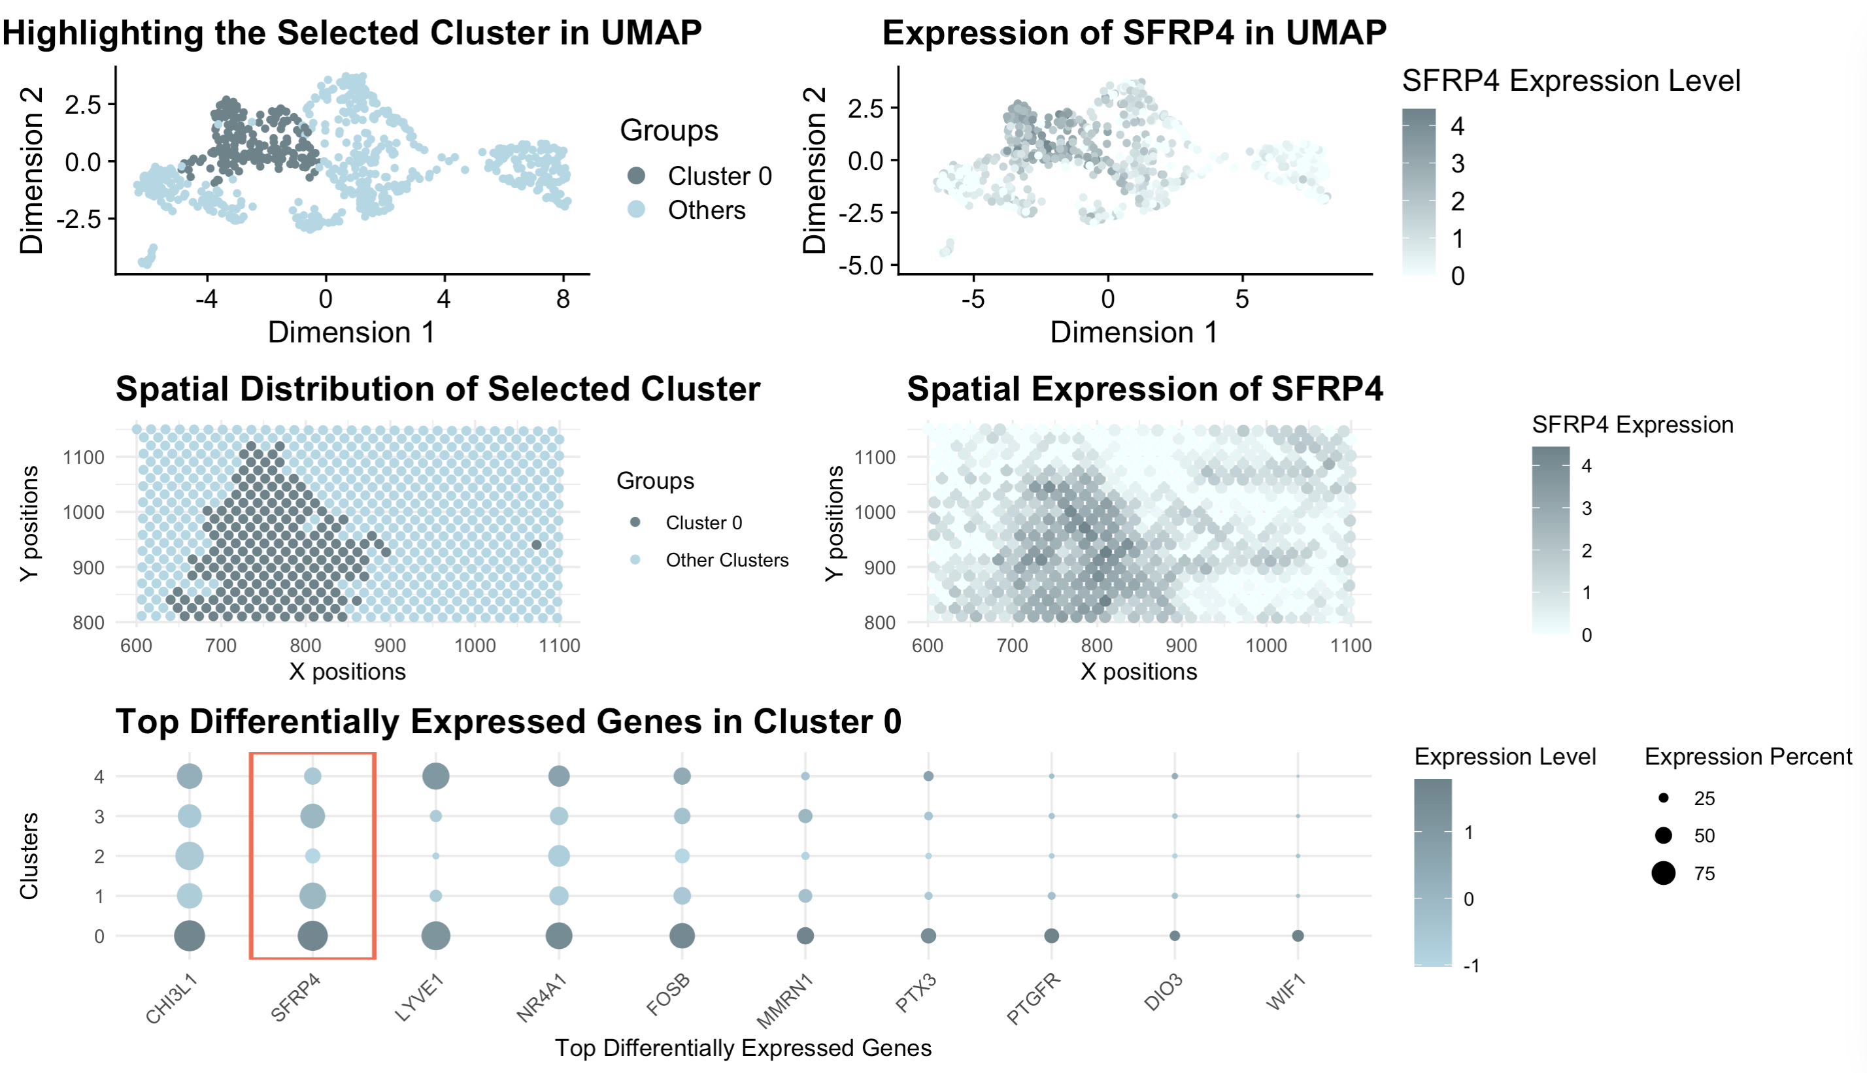


Slide 6
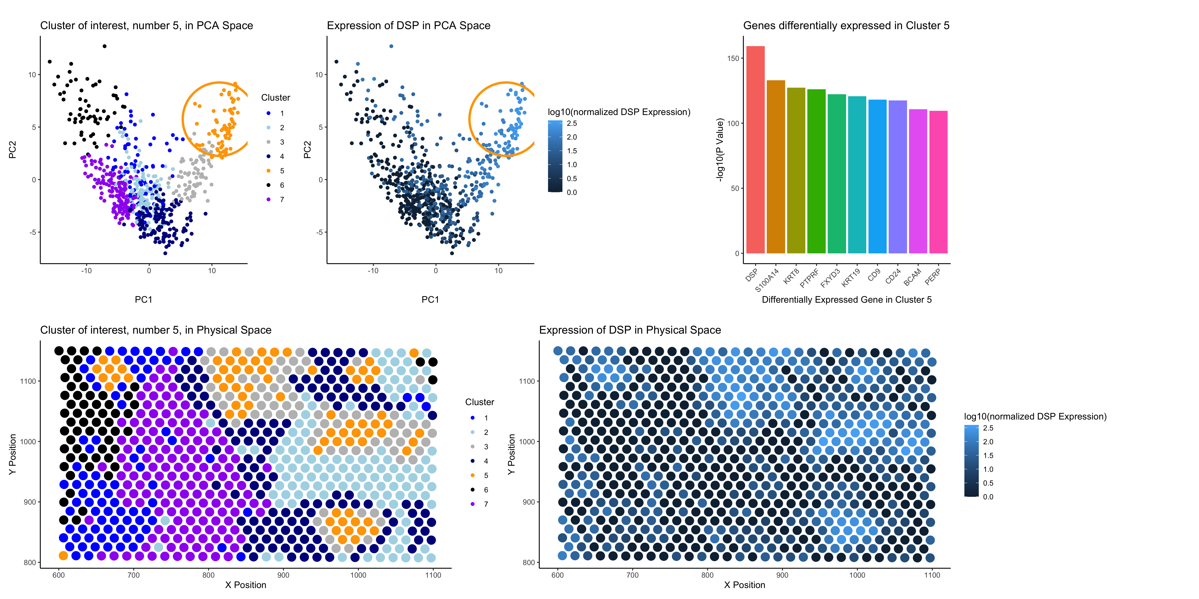


Slide 7
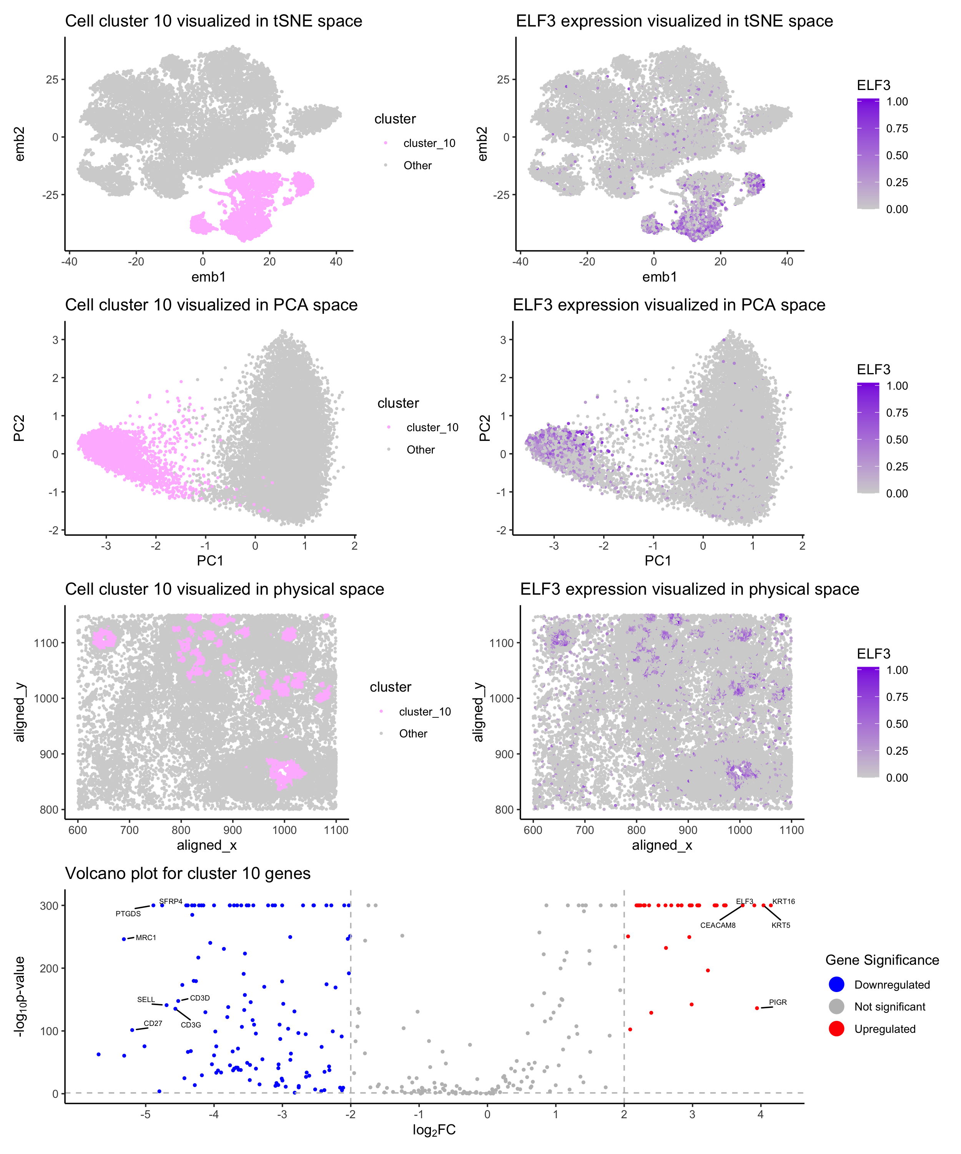


Slide 8
(Vizgen 2021)
Notes:
What these technologies allow us to do is not only image where cells are within fixed tissues (here we have a cortical section of the mouse cortex)

Slide 9
(Vizgen 2021)
Notes:
But we can see how genes are expressed within these cells within the tissues
With red being high expression and blue being low expression f
or a targeted set of genes

Slide 10
(Vizgen 2021)
Notes:
But we can see how genes are expressed within these cells within the tissues
With red being high expression and blue being low expression f
or a targeted set of genes

Slide 11
(Vizgen 2021)
Notes:
But we can see how genes are expressed within these cells within the tissues
With red being high expression and blue being low expression f
or a targeted set of genes

Slide 12
(Vizgen 2021)
Notes:
But we can see how genes are expressed within these cells within the tissues
With red being high expression and blue being low expression f
or a targeted set of genes

Slide 13
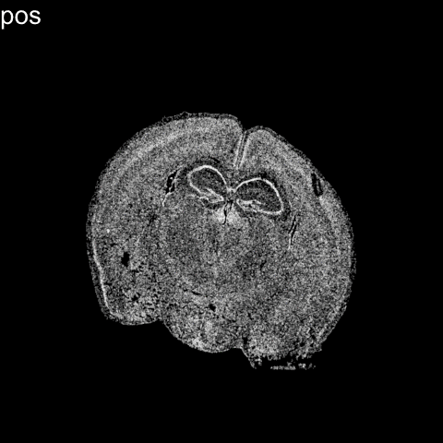


Slide 14
Limitation: cells are fixed
Expression measurements represent static snapshots in time

Slide 15









Slide 16
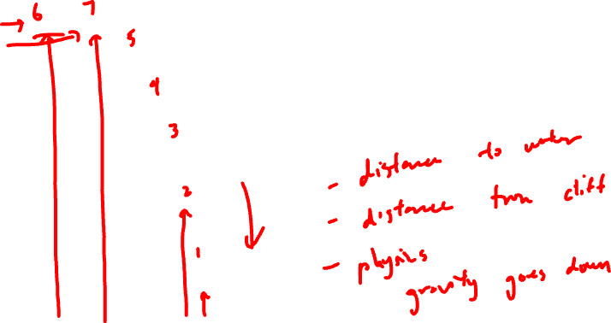
pseudotemporal ordering

Slide 17

directed pseudotemporal ordering

Slide 18







Distance away from the water

Slide 19
Distance away from the rock ledge

Slide 20
OPCs
Genes to be downregulated as a cell matures
Mature
Oligoden
drocytes

Slide 21
OPCs
Genes to be upregulated as a cell matures
Mature
Oligoden
drocytes

Slide 23
pseudotemporal ordering

Slide 24
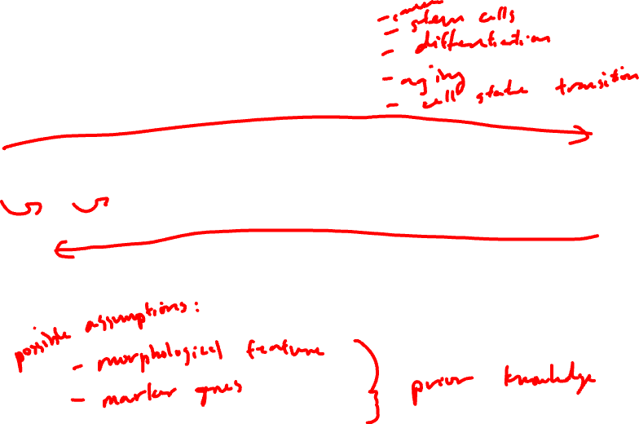
Which way does it go?

Slide 25
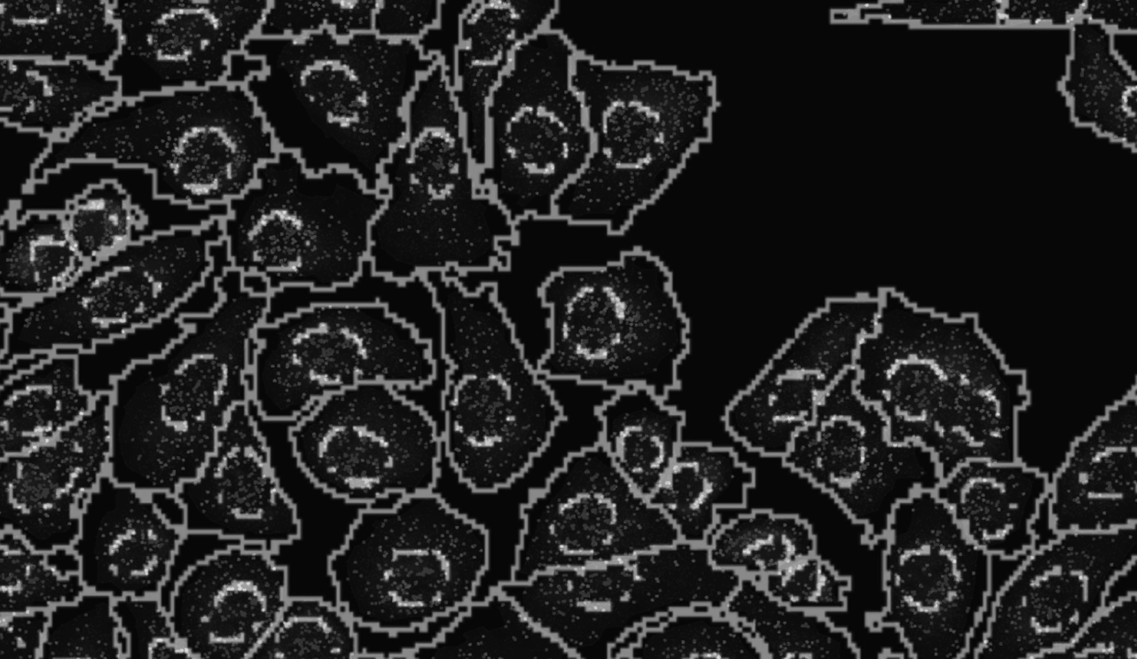
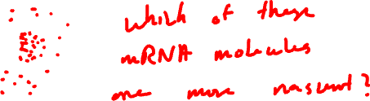

Slide 26
Nuclear vs. cytoplasmic subcellular organization of mRNAs is linked to the regulation of protein expression
(La Manno, et al Nature, August 2018)
(Xia*, Fan*, Emanuel*, et al PNAS, Sept 2019)

Slide 27
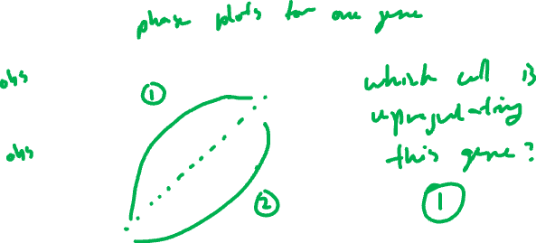
Nuclear vs. cytoplasmic subcellular organization of mRNAs is linked to the regulation of protein expression
Oligodendrocyte
maturation marker
(La Manno, et al Nature, August 2018)
(Xia*, Fan*, Emanuel*, et al PNAS, Sept 2019)

Slide 28
Nuclear vs. cytoplasmic subcellular organization of mRNAs is linked to the regulation of protein expression
(La Manno, et al Nature, August 2018)
(Xia*, Fan*, Emanuel*, et al PNAS, Sept 2019)

Slide 29
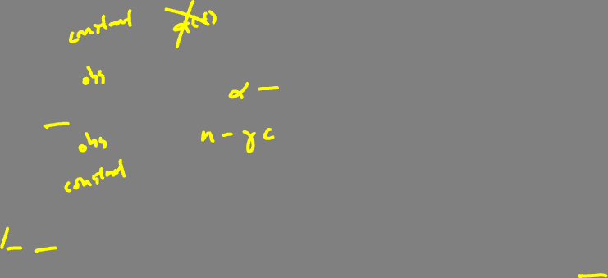
RNA velocity in situ analysis leverages nuclear and cytoplasmic gene expression to predict the future transcriptional state of cells
(La Manno, et al Nature, August 2018)
(Xia*, Fan*, Emanuel*, et al PNAS, Sept 2019)

Slide 30

RNA velocity in situ analysis leverages nuclear and cytoplasmic gene expression to predict the future transcriptional state of cells
(La Manno, et al Nature, August 2018)
(Xia*, Fan*, Emanuel*, et al PNAS, Sept 2019)

Slide 31

RNA velocity in situ analysis leverages nuclear and cytoplasmic gene expression to predict the future transcriptional state of cells
(La Manno, et al Nature, August 2018)
(Xia*, Fan*, Emanuel*, et al PNAS, Sept 2019)

Slide 32

RNA velocity in situ analysis leverages nuclear and cytoplasmic gene expression to predict the future transcriptional state of cells
Assuming constant velocity
(La Manno, et al Nature, August 2018)
(Xia*, Fan*, Emanuel*, et al PNAS, Sept 2019)

Slide 33

RNA velocity in situ analysis leverages nuclear and cytoplasmic gene expression to predict the future transcriptional state of cells
Assuming constant velocity
(La Manno, et al Nature, August 2018)
(Xia*, Fan*, Emanuel*, et al PNAS, Sept 2019)

Slide 34


RNA velocity in situ analysis leverages nuclear and cytoplasmic gene expression to predict the future transcriptional state of cells
Oligodendrocyte
maturation marker
Assuming constant velocity
(La Manno, et al Nature, August 2018)
(Xia*, Fan*, Emanuel*, et al PNAS, Sept 2019)
Notes:
What is the future c(t+dt) for cells are steady state?

Slide 35

RNA velocity in situ analysis leverages nuclear and cytoplasmic gene expression to predict the future transcriptional state of cells
(Xia*, Fan*, Emanuel*, et al PNAS, Sept 2019)
Notes:
Indeed

Slide 36

Clustering analysis identifies transcriptionally distinct cell states among cultured U2OS cells
matrix of
gene x cell
(Xia*, Fan*, Emanuel*, et al PNAS 2019)

Slide 37
Clustering analysis identifies transcriptionally distinct cell states among cultured U2OS cells
matrix of
gene x cell
(Xia*, Fan*, Emanuel*, et al PNAS 2019)

Slide 38
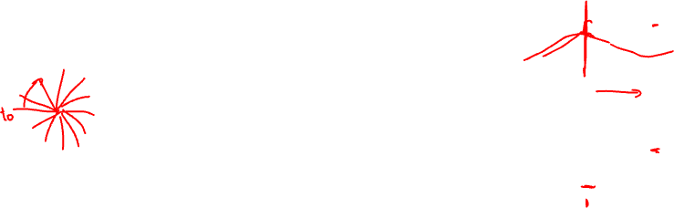

RNA velocity in situ analysis provides a directed ordering of cells so we can look at gene expression as a function of pseudotime
MCM6
KIF2C
(Xia*, Fan*, Emanuel*, et al PNAS 2019)
Notes:
MCM6: encodes a protein that is a component of the Minichromosome Maintenance Complex essential for the initiation of eukaryotic genome replication in G1/S phase transition
KIF2C: encodes a kinesin-like protein that is involved mitotic chromosome segregation during M phase

Slide 39

Pseudotime analysis identifies new cell-cycle genes and highlights gradual transcriptional change throughout select cell-cycle stages
Novel
Known
(Xia*, Fan*, Emanuel*, et al PNAS 2019)

Slide 40
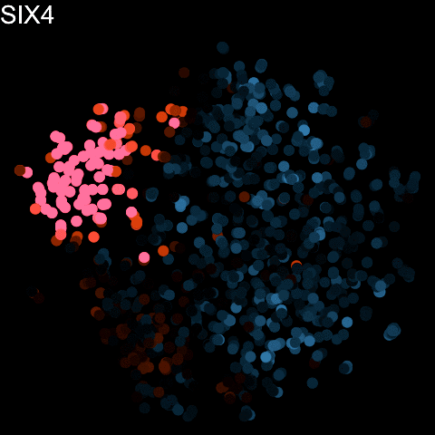

Slide 41
For those interesting in background: RNA velocity in single-cell sequencing

Slide 42
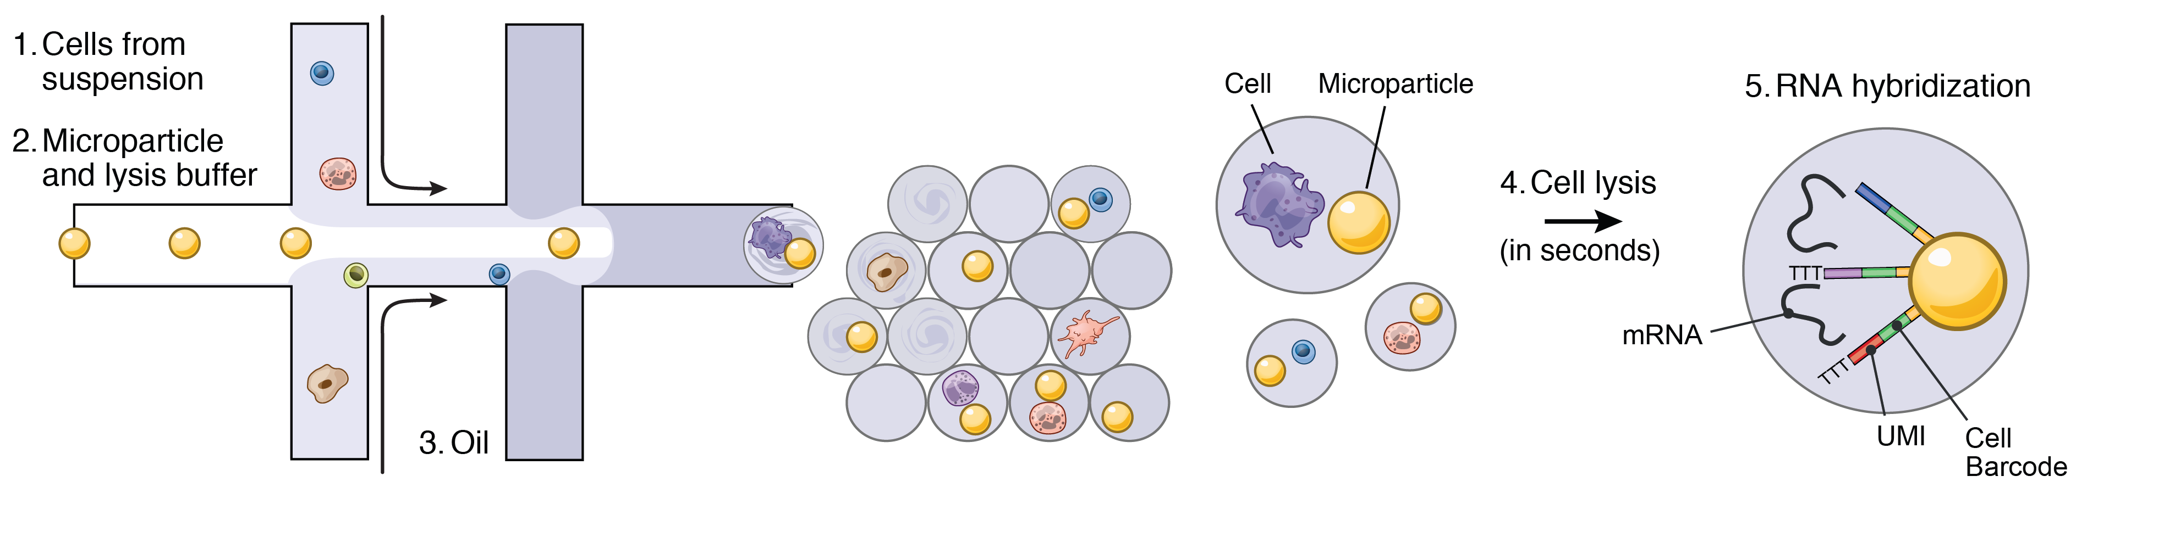
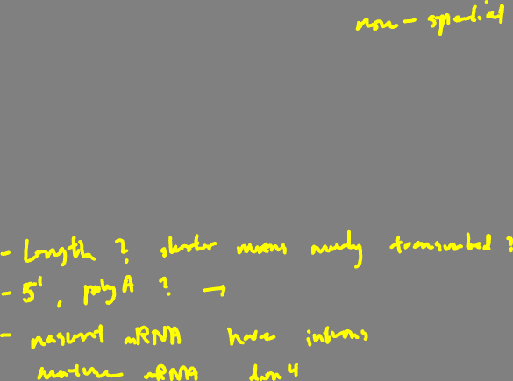
RNA Velocity analysis started with single-cell RNA sequencing…how did the authors distinguish nascent from mature RNAs?

Slide 43

RNA velocity analysis leverages spliced and unspliced gene expression to predict the future transcriptional state of cells
(La Manno, et al Nature 2018)

Slide 44
RNA velocity analysis leverages spliced and unspliced gene expression to predict the future transcriptional state of cells
(La Manno, et al Nature 2018)

Slide 45
Dimensionality reduction and clustering analysis identifies transcriptionally distinct groups of cells in single cell RNA-seq data
matrix of
gene x cell
(La Manno, et al Nature 2018)

Slide 46
RNA Velocity analysis relates these groups of cells as a part of an underlying directed cellular trajectory
matrix of
gene x cell
(La Manno, et al Nature 2018)

Slide 47

(La Manno, et al Nature 2018)
Notes:
Which cell-type is the stem-cell type that gives rise to all these other cell-types?

Slide 48

Resources
Try out the software: http://velocyto.org/
https://scvelo.readthedocs.io/en/stable/
Little challenging to install so we will skip this
Hands on component
Interactive visualizations with gganimate

